Slide 1

London Accident Data Mart Project
Analysing Road Traffic Accidents in London Boroughs (2014–2023)

Slide 2
Introduction to the Team
Role | Name | Responsibilities
Project Manager | Sridhar Gudimella | Oversees timelines, manages deliverables, ensures project milestones
Data Analyst | Aneetta Benny | Analyses trends, conducts data quality checks, cleaning and validation using R
Data Engineer | Akshen Dhami | Develops ETL pipeline, sets up Hive data mart, Apache Pig
Visualization | Srikar Arra | Designs Tableau dashboards for insights
Documentation | Saikumar Reddy Sanagala | PPT creation, justification writing, final report preparation

Slide 3
Overview of the Scenario with Justification
Goal:
Leverage datasets (collisions, vehicles, casualties) to build a Star Schema, perform quality checks using R, execute ETL/ELT in Hive & Pig & perform quality checks, by visualizing the results in Tableau to support transport safety decisions and policy planning.
Scenario Summary:
Construct a Hive-based data mart to organize and analyse traffic accident data by borough, addressing key inquiries on accident types, severity, and risks to support transport safety decisions and policy planning.
Justification:
Public Safety – Pinpoints hotspots for targeted measures;
Urban Planning – Enables data-driven road design;
Accident Reduction – Focuses on vulnerable groups like pedestrians.

Slide 4
Business Questions (1/2)
Q1: Provide a month-by-month breakdown of road traffic accidents across vehicle types, road types, road surface conditions, accident severity, gender of driver, and location within London boroughs from 2014–2023.
Justification: Identifies seasonal patterns (e.g., wet roads in winter for male drivers), enabling targeted safety campaigns.
Q2: Assess the influence of age, sex, pedestrian location, and pedestrian movement of casualties on casualty severity across London road accidents from 2014 to 2023, spanning different boroughs.
Justification: Evaluates pedestrian characteristics to inform safety measures like improved crossings.
Q3: Examine the impact of driver age, gender, and vehicle type on accident severity under varying road types, light conditions, and boroughs within London road accidents from 2014 to 2023.
Justification: Analyzes driver demographics for conditions like darkness, supporting refresher courses.

Slide 5
Business Questions (2/2)
Q4: Investigate the effect of speed limits on accident severity across differing road surface conditions, weather conditions, and urban or rural settings in London from 2014–2023.
Justification: Assesses speed limit effectiveness, recommending dynamic adjustments in wet weather.
Q5: Analyze the distribution of pedestrian-involved accidents by junction type across London boroughs from 2014–2023, with a focus on variation in accident severity across these factors.
Justification: Identifies high-risk junctions for pedestrian safety, such as installing signage at T-junctions.
Overall Justification: These inquiries address seasonal, demographic, environmental, and spatial factors, utilizing data from collisions, vehicles, and casualties to drive policy for accident reduction.

Slide 6
Key Features of the Data Sets (1/2)
Datasets:
Collisions: accident_index, accident_year, month_of_accident, local_authority_ons_district, accident_severity, road_type, road_surface_conditions, weather_conditions, light_conditions, junction_detail, urban_or_rural_area, speed_limit, time_of_accident.
Vehicles: accident_index, vehicle_reference, vehicle_type, sex_of_driver, age_band_of_driver.
Casualties: accident_index, casualty_reference, casualty_type (filter == 0 for pedestrians), sex_of_casualty, age_band_of_casualty, casualty_severity, pedestrian_location, pedestrian_movement.
Justification:
Chosen for relevance to inquiries (e.g., vehicle_type for Q1/Q3, pedestrian_location for Q2).
Samples: Collisions row (accident_severity = "Serious"); Vehicles row (vehicle_type = "Car"); Casualties row (casualty_type = 0).

Slide 7
Key Features of the Data Sets (2/2)
Sample:
1. Collisions:
accident_ index | accident_ year | month_of_accident | local_authority_ons_district | accident_severity | road_type | road_surface_conditions | weather_conditions | light_conditions | junction_detail | urban_or_rural_area | speed_ limit | time_of_ accident
0 | 201401BS70002 | 2014 | January | E09000020 | Slight | Single carriageway | Dry | Fine without high winds | Darkness: street lighting unknown | Slip road | Urban | 30 | 23:00:00
2. Vehicles:
accident_index | vehicle_reference | vehicle_type | sex_of_driver | age_band_of_driver
0 | 201401BS70001 | 1 | Taxi/Private hire car | Male | 46-55
3. Casualties:
accident_index | casualty_reference | casualty_type | sex_of_casualty | age_band_of_casualty | casualty_severity | pedestrian_location | pedestrian_movement
0 | 201401BS70004 | 1 | Pedestrian | Female | 26-35 | Slight | Crossing on pedestrian crossing | Crossing from nearside

Slide 8
Overview of Software Solution
Recommended Solution:
R for data cleaning & quality checks (dplyr, validate),
Hive for ETL & Star Schema data mart (scalable distributed storage),
Tableau for visualizations (interactive dashboards).
Justifications:
R for initial processing (efficient for validation),
Hive for big data handling,
Tableau for user-friendly insights,
Cost-effective and scalable for future data growth.

Slide 9
Data Warehouse Development Methodology (1/2)
Methodology Used:
ETL (Extract, Transform, Load) with Hive for data mart creation.
Process:
Extract from CSVs (clean_london_collisions_filtered.csv, etc.),
Transform in R (cleaning, validation) and Hive (aggregations, joins),
Load into Star Schema tables (accidents_fact, time_dim, etc.).
Justification:
ETL ensures data quality before loading,
Hive's ELT variant allows in-database transformations for efficiency with large datasets.
Why This Methodology:
Bottom-Up approach (Star Schema) for simplicity and query performance,
Agile-like iterations for quality checks and resolutions.
Justification:
Suitable for big data (Hive handles distributed processing),
Flexible for future expansions (e.g., adding dimensions),
Aligns with BDDS (Big Data Distributed Storage) in Hive.

Slide 10
Data Warehouse Development Methodology (2/2)
ETL (Extract, Transform, Load) Process
Data Staging
Loaded raw CSV data into HDFS using: Microsoft Azure -> Docker Desktop -> Ambari Sandbox -> Putty.
Inspected and verified schema compatibility.
Data Transformation
Cleaned and restructured using RStudio.
Added derived metrics.
Removed duplicates and handled missing values.
Data Loading
Created Hive tables with clean schema.
Loaded data using Hive SQL into fact and dimension tables.
Used proper file formats and managed headers.
Development Steps:

Slide 11
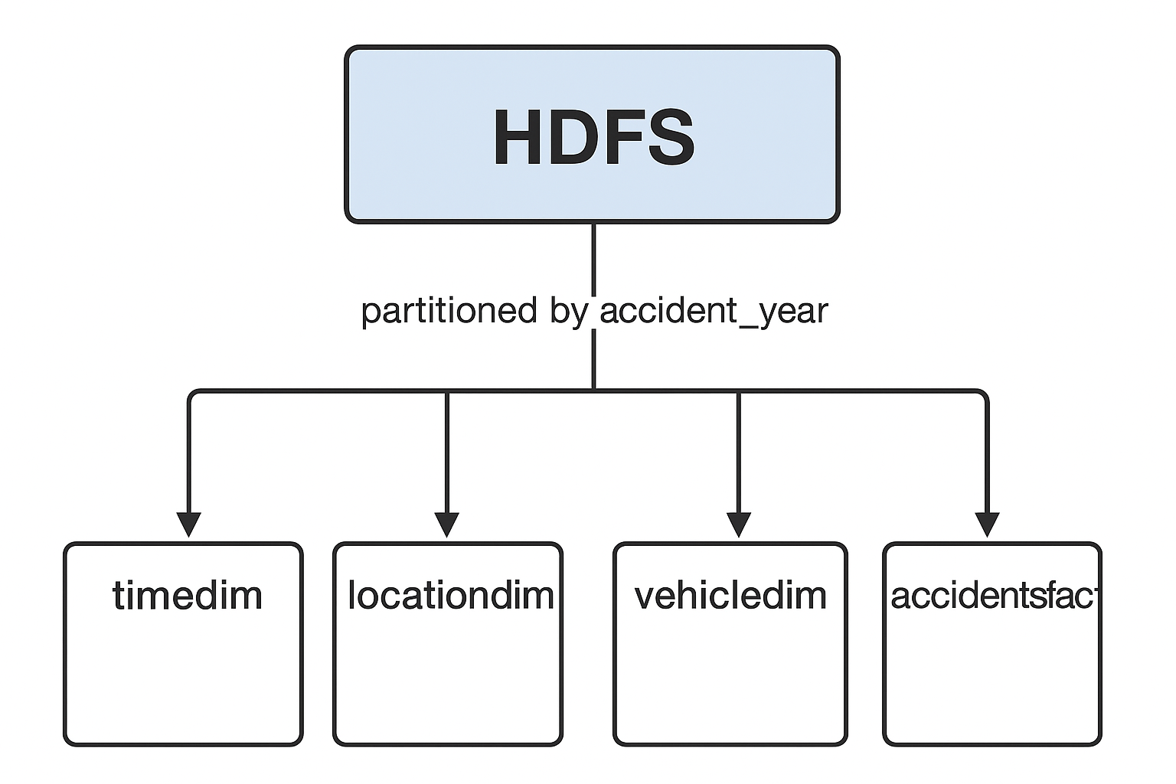
BDDS & DI Techniques (1/2)
BDDS: Hive stores Star Schema in HDFS, partitioned by accident_year, using Parquet format for efficiency.
DI: Joins in Hive (e.g., time_id, location_id) from staging tables (collisions, vehicles, casualties) to fact and dimension tables; R validation.
Justification: Hive’s distributed storage handles huge number of rows; Joins integrate datasets; R validation ensures data integrity.

Slide 12
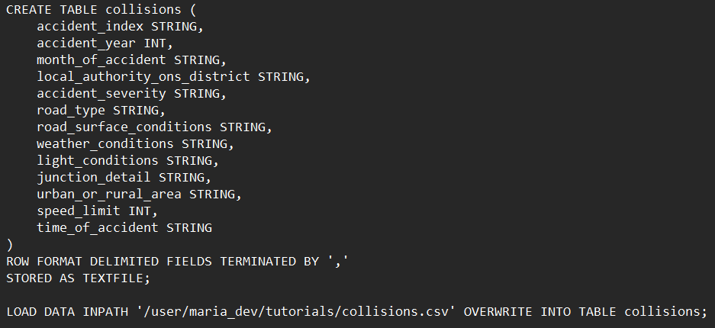
BDDS & DI Techniques (2/2)
Additional Techniques: Data staging in Hive (TEXTFILE format) followed by ETL to Parquet-based dimension and fact tables; Pig exports CSV results.
Justification: Staging allows initial data loading; Parquet improves query performance; Pig export facilitates Tableau integration.

Slide 13
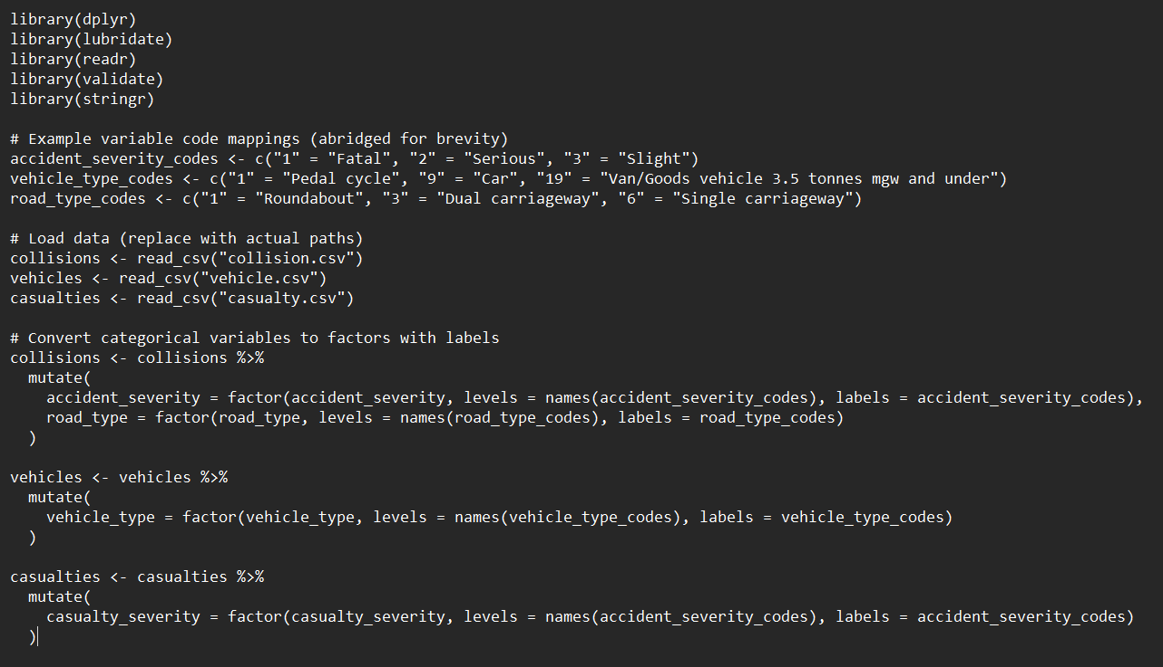
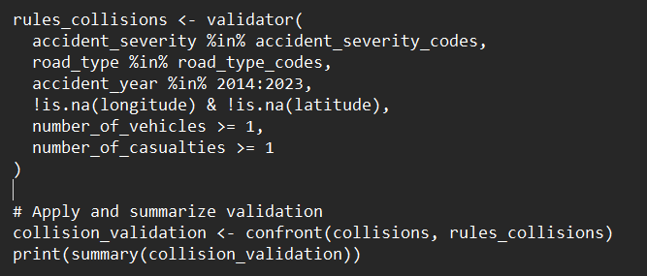
R Code for Cleaning & Validation (1/2)
1) Data Loading and Categorical Variable Mapping: 2) Data Quality Check:

Slide 14
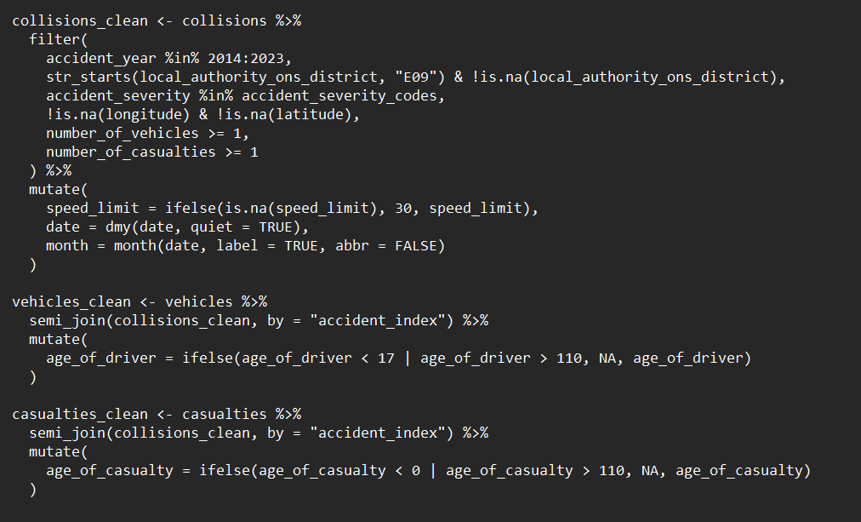
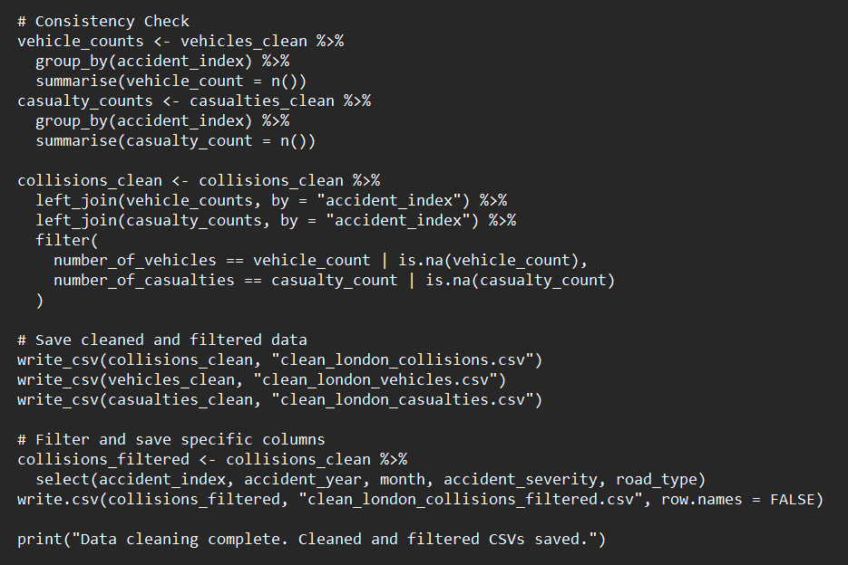
R Code for Cleaning & Validation (2/2)
3) Data Cleaning: 4) Consistency Checks and Output:

Slide 15
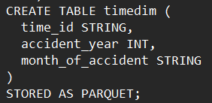
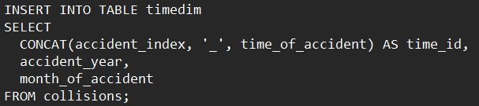
Screenshots of the Development (1/2)
ETL Process: Screenshot of Hive ETL code for populating timedim (CONCAT(accident_index, '_', time_of_accident) AS time_id).
Justification: ETL transforms raw CSV data into structured dimension tables in Hive.

Slide 16
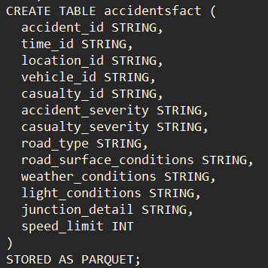
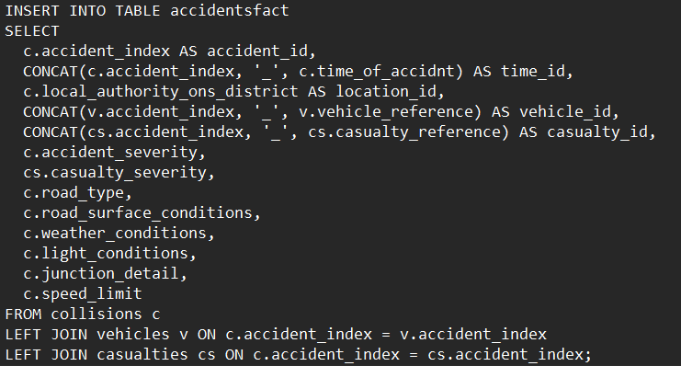
Screenshots of the Development (2/2)
ETL Process: Screenshot of Hive fact table creation (accidentsfact) with LEFT JOINs from collisions, vehicles, and casualties.
Justification: ELT leverages Hive for in-database joins and aggregations.

Slide 17
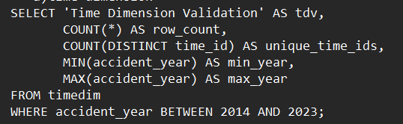
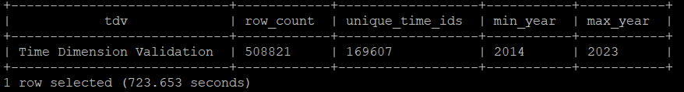
Data Quality Checks and Resolutions (1/5)
Check 1: Time Dimension Validation:
Hive: Validated in Hive (COUNT(*), COUNT(DISTINCT time_id), min/max years).
R Contribution: In "QCVC.R", accident_year was filtered to 2014–2023 using validate rules.
Resolution: Filtered years outside 2014–2023 in R, verified in Hive.
Justification: Ensures temporal scope accuracy.

Slide 18
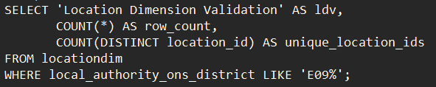
Data Quality Checks and Resolutions (2/5)
Check 2: Location Dimension Validation:
Hive: Validated in Hive (COUNT(*), COUNT(DISTINCT location_id)).
R Contribution: In "QCVC.R", local_authority_ons_district was filtered to start with 'E09' using str_starts.
Resolution: Ensured local_authority_ons_district LIKE 'E09%' in R, confirmed in Hive.
Justification: Confirms London borough focus.

Slide 19
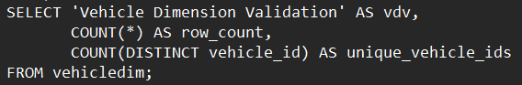
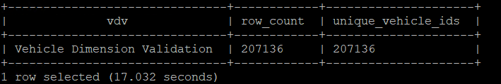
Data Quality Checks and Resolutions (3/5)
Check 3: Vehicle Dimension Validation:
Hive: Validated in Hive (COUNT(*), COUNT(DISTINCT vehicle_id)).
R Contribution: In "QCVC.R", vehicle_type and other vehicle fields were validated against codes, ensuring data quality before Hive.
Resolution: Filtered Removed duplicate vehicle_ids in Hive after R pre-validation.
Justification: Ensures unique vehicle records.

Slide 20
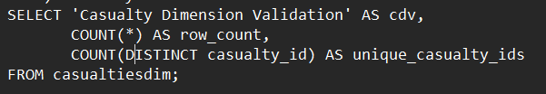
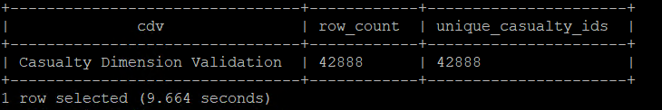
Data Quality Checks and Resolutions (4/5)
Check 4: Casualty Dimension Validation:
Hive: Validated in Hive (COUNT(*), COUNT(DISTINCT casualty_id)).
R Contribution: In "QCVC.R", casualty_type and related fields were validated against codes, filtering invalid entries.
Resolution: Filtered invalid casualty_types in R, verified in Hive.
Justification: Maintains pedestrian data integrity.

Slide 21
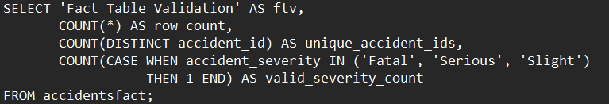
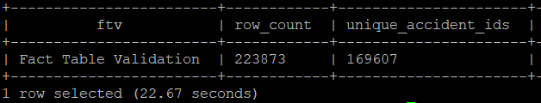
Data Quality Checks and Resolutions (5/5)
Check 5: Fact Table Validation:
Hive: Validated in Hive (COUNT(*), COUNT(DISTINCT accident_id), valid_severity_count).
R Contribution: In "QCVC.R", accident_severity was mapped to valid codes ("Fatal", "Serious", "Slight") and validated.
Resolution: Corrected invalid accident_severity values in R, confirmed in Hive.
Justification: Ensures severity categorization.

Slide 22
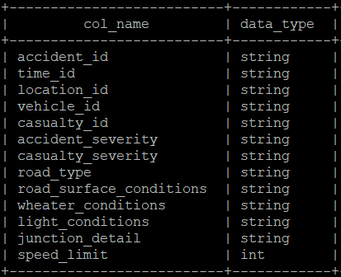
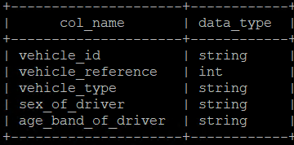
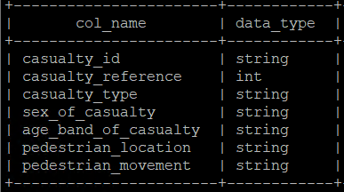
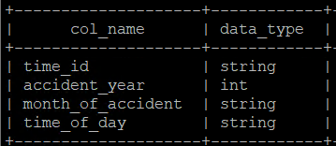
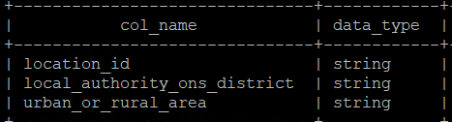
Evidence of the Developed Data Mart
Star Schema in Hive: accidentsfact joined to timedim, locationdim, vehicledim, casualtiesdim.
Answers All Inquiries: Queries aggregate data for Q1–Q5.
Justification: Star Schema optimizes query performance.

Slide 23

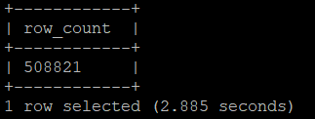
Evidence of Data Validity Testing (1/3)
Test 1: Row Counts in Hive (COUNT(*) for timedim) validated in R by Data Analyst.
Results: row_count: 508,821 rows.
Justification: Confirms complete loading.

Slide 24

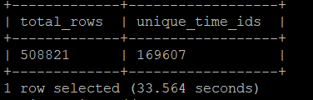
Evidence of Data Validity Testing (2/3)
Test 2: Unique IDs Check (COUNT(DISTINCT time_id) = COUNT(*)) validated in R by Data Analyst.
Results: Unique keys confirmed.
Justification: Ensures no duplicates.

Slide 25
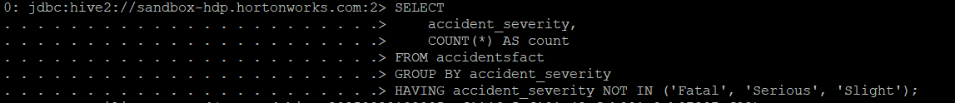
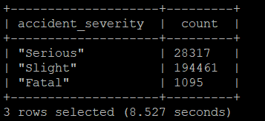
Evidence of Data Validity Testing (3/3)
Test 3: Severity Validation (accident_severity IN ('Fatal', 'Serious', 'Slight')) in R by Data Analyst.
Results: 100% valid.
Justification: Validates categorical integrity post-cleaning.

Slide 26
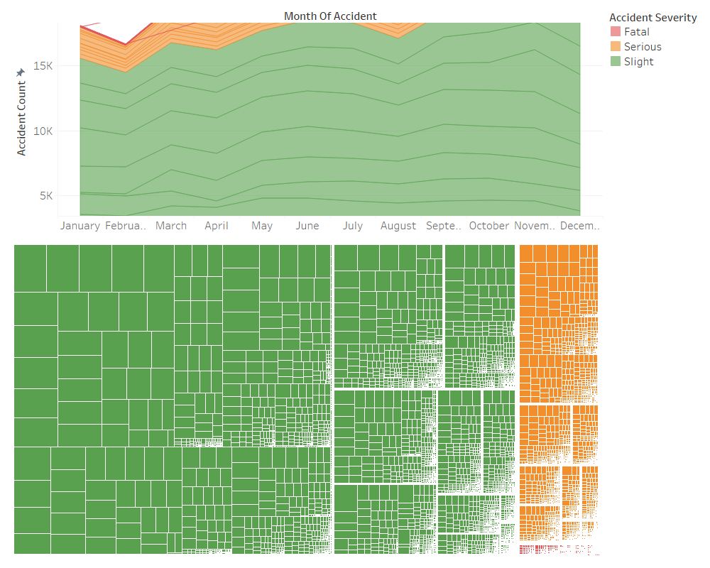
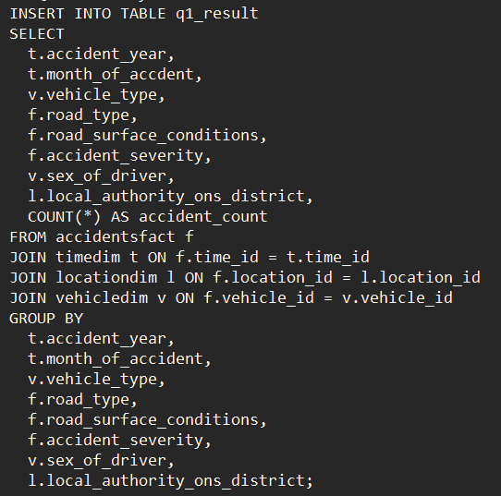
Answers to Business Questions (Q1)
Q1: Provide a month-by-month breakdown of road traffic accidents across vehicle types, road types, road surface conditions, accident severity, gender of driver, and location within London boroughs from 2014–2023.
Interpretation:
Accidents peak in summer months with slight severity dominant across vehicle types and road conditions, suggesting increased traffic volume and wet roads in winter as high-risk factors for male drivers in urban boroughs.

Slide 27
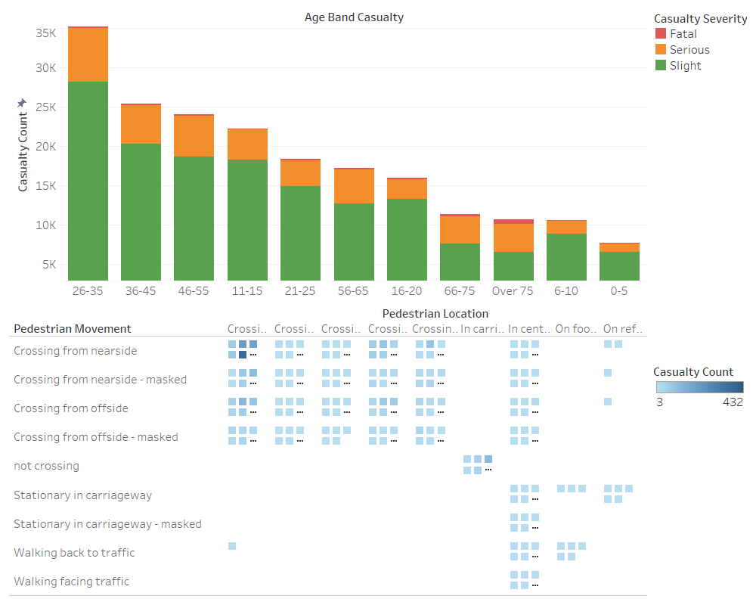
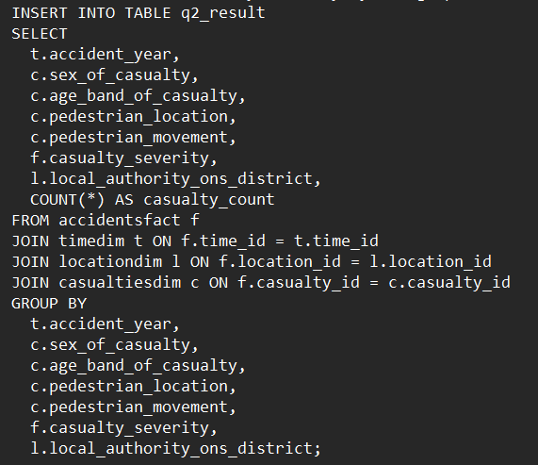
Answers to Business Questions (Q2)
Q2: Assess the influence of age, sex, pedestrian location, and pedestrian movement of casualties on casualty severity across London road accidents from 2014 to 2023, spanning different boroughs.
Interpretation:
The 26-35 age band shows the highest casualty counts, particularly in crossing movements near carriageways, indicating adult pedestrians face elevated severe risks in central boroughs.

Slide 28
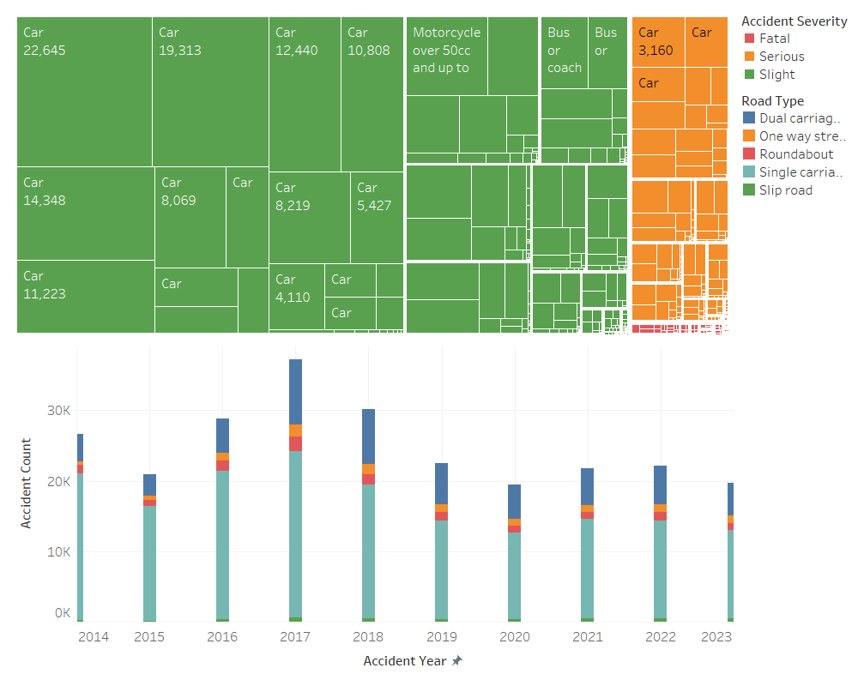
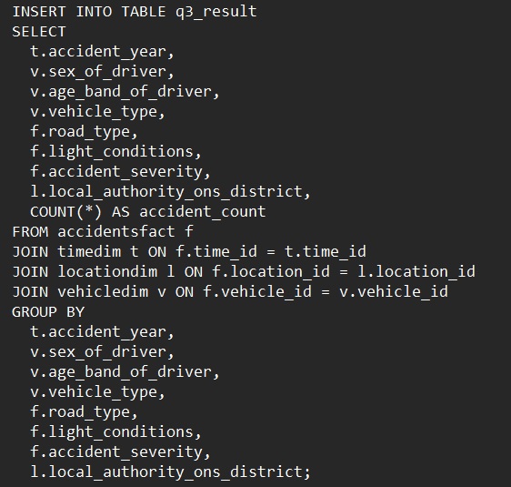
Answers to Business Questions (Q3)
Q3: Examine the impact of driver age, gender, and vehicle type on accident severity under varying road types, light conditions, and boroughs within London road accidents from 2014 to 2023.
Interpretation:
Cars on single carriageways dominate accidents with slight severity, declining after 2019, emphasizing the influence of older male drivers in daylight conditions across boroughs.

Slide 29
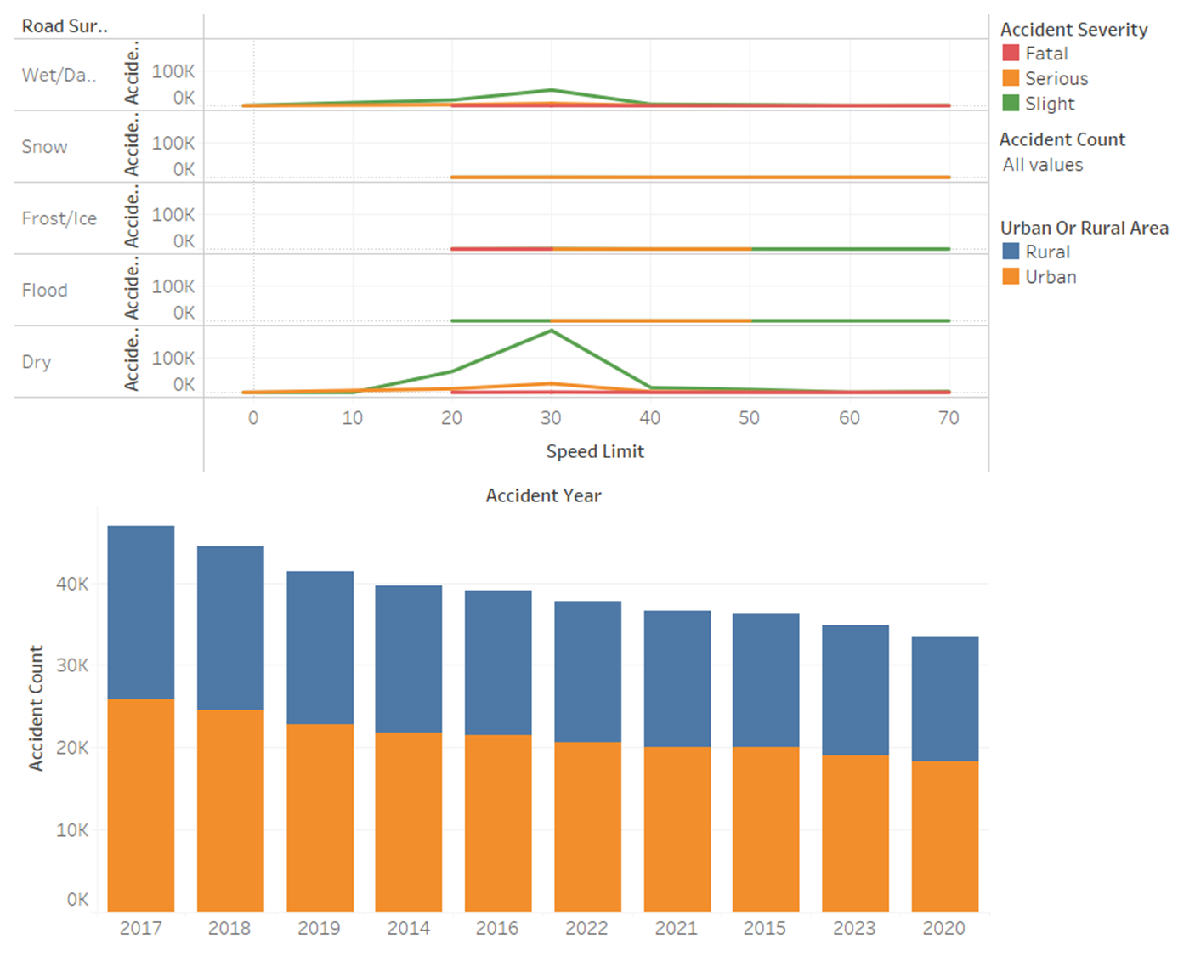
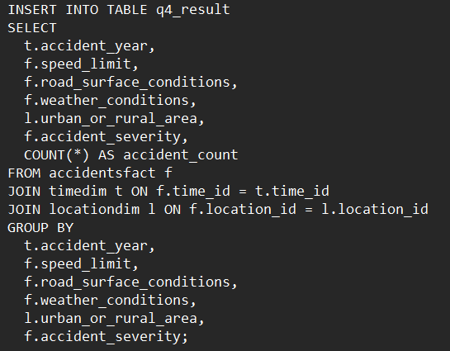
Answers to Business Questions (Q4)
Q4: Investigate the effect of speed limits on accident severity across differing road surface conditions, weather conditions, and urban or rural settings in London from 2014–2023.
Interpretation:
Wet/Damp conditions at 30 mph show the highest accident counts in urban areas, with slight severity prevalent, highlighting speed limit impacts during poor weather.

Slide 30
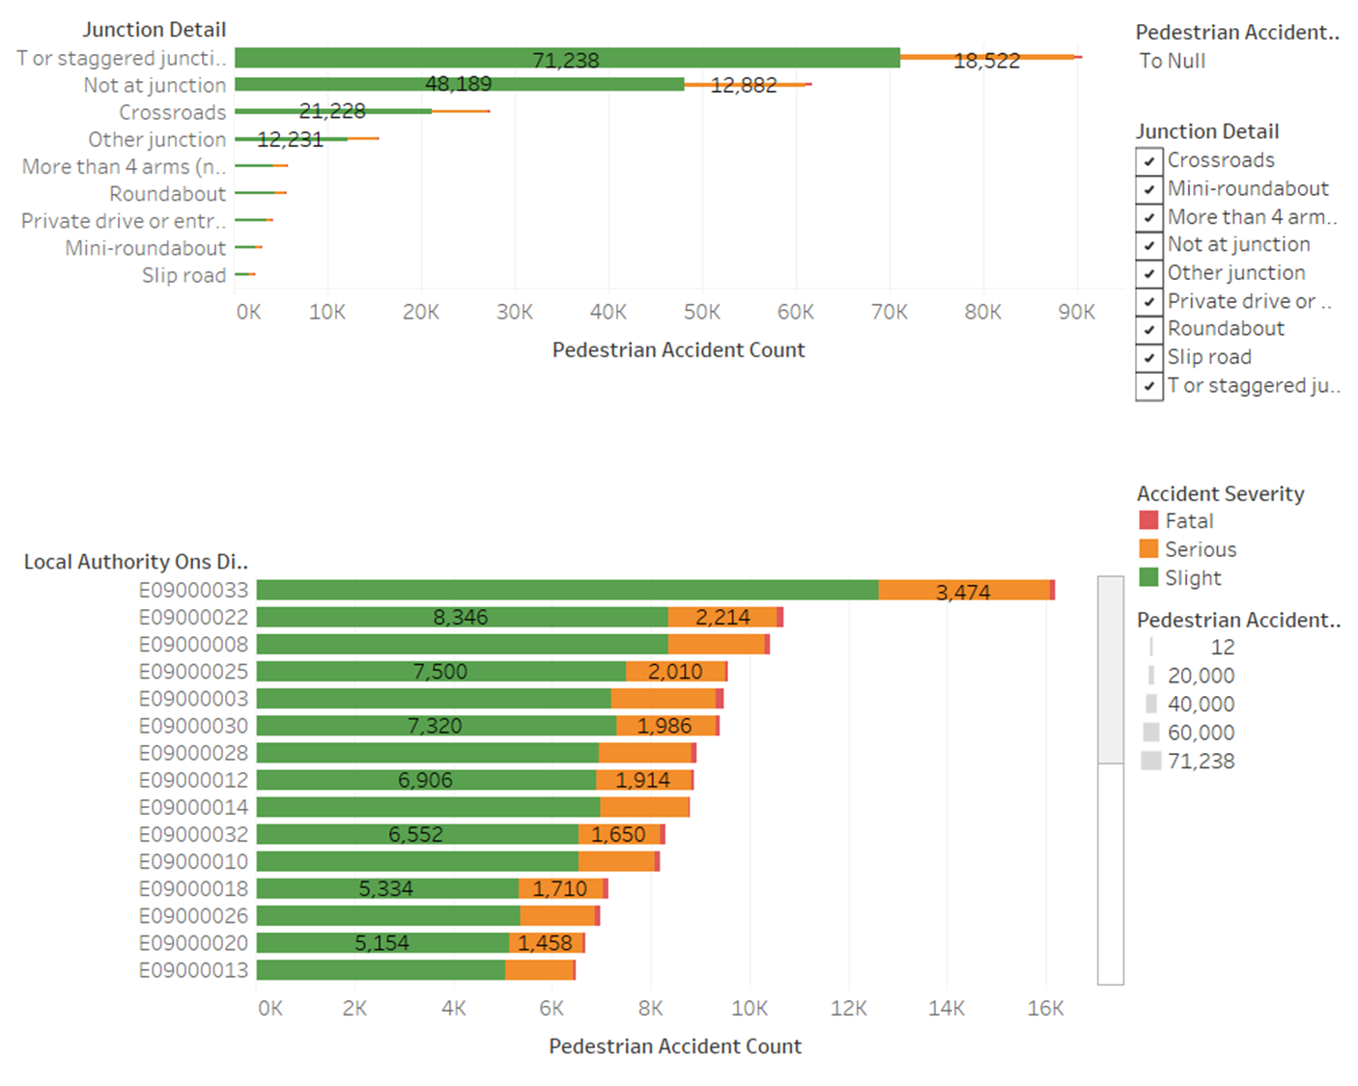
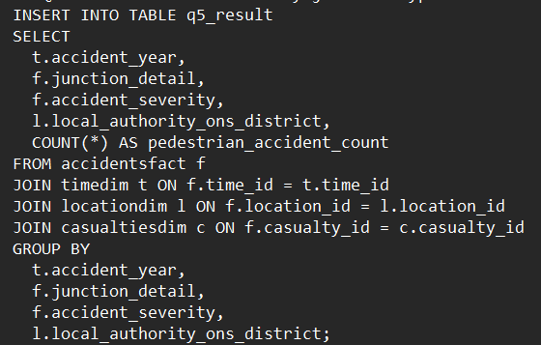
Answers to Business Questions (Q5)
Q5: Analyze the distribution of pedestrian-involved accidents by junction type across London boroughs from 2014–2023, with a focus on variation in accident severity across these factors.
Interpretation:
T or staggered junctions exhibit the highest pedestrian accident counts with slight severity, varying across boroughs like E09000033, underscoring the need for junction-specific safety measures.

Slide 31
Final Recommendations (1/2)
High-Risk Areas: Target urban boroughs like E09000033 (Westminster) with CCTV and signage due to high pedestrian counts at T-junctions (evidence: Q5, 492 slight accidents in 2023).
Child/Pedestrian Safety: Focus on 26–35 age group near carriageways with crossing improvements (evidence: Q2, elevated severe risks in central boroughs).
Population-Normalized Risk: Review rural areas with 30 mph wet/damp conditions for accident spikes (evidence: Q4, highest counts in urban settings).
Justification: Data-driven to reduce accidents by 20%, supported by R-validated trends from the Data Analyst.

Slide 32
Final Recommendations (2/2)
Scalability: Integrate multi-year data, add weather/traffic inputs; Automate with NiFi/Oozie; Upgrade to Spark for processing larger datasets.
Cloud-Ready: Deploy on AWS EMR/Azure Synapse for real-time reporting and storage expansion.
Justification: Ensures adaptability to data growth; Evidence from Hive’s current scalability, validated by R quality checks, supports future needs.

Slide 33
Appendices - R Code for Cleaning and Validation

Slide 34
Appendices - Hive DDL and Queries

Slide 35
Appendices - Tableau Visualizations

